Slide 1




Slide 2
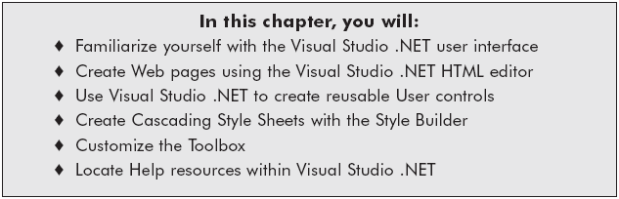
Chapter Objectives

Slide 3
Visual Studio .NET User Interface
Integrated Development Environment (IDE) – shared development environment
Document windows (Edit & view documents)
Resource Tools (Windows, Toolbox, Toolbars)
  Main Window – create and view project files
  Solution Explorer – manage project files and resources
  Server Explorer window – access server public components, manage connections to databases

Slide 4
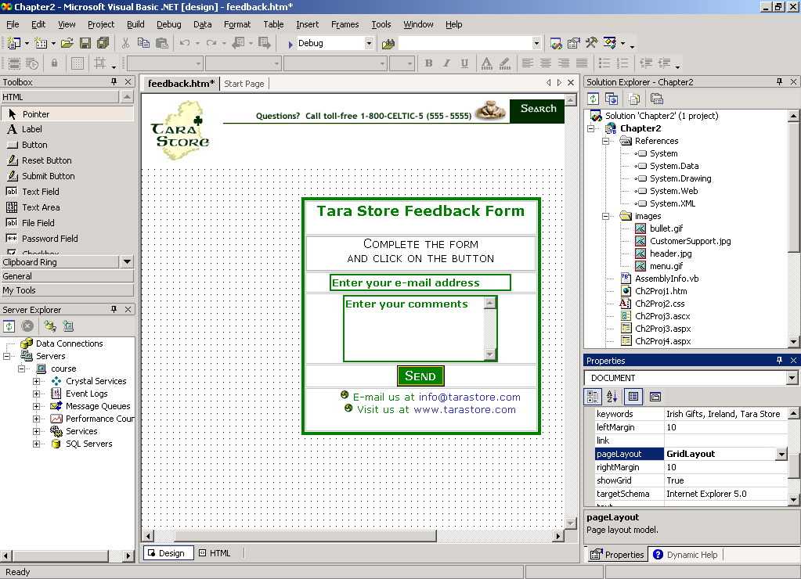
Visual Studio .NET IDE Layout

Slide 5
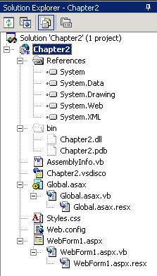
The Solution Explorer Window

Slide 6
Visual Studio .NET User Interface (continued)
Resource Tools (continued)
  Properties window – set properties for objects, controls, and classes
  Document Tab – allows you to easily switch between open documents
  Toolbox – contains commonly used controls

Slide 7
Creating a Web Application
A solution may contain pointers to many projects
  Solution files are stored in a folder in the Visual Studio Projects folder
Project name is the folder name
  By default, project name is the solution name
  Project files are stored in the same folder or with the Web site
Web Server name
  localhost, the machine name, IP address or 127.0.0.1
  Default Web site is http://localhost/[ProjectName]/ such as http://localhost/Chapter2/

Slide 8
Creating a Web Application (continued)
Create the Chapter2 project (PP. 47-48)
  Make sure to verify that Visual Basic Projects is selected in Project Types pane
  Select the ASP.NET Web Application template
  Name the solution & project Chapter2, so the location is http://localhost/Chapter2
  View the default files, the hidden files within the Solution Explorer window

Slide 9
Navigating the Windows
Window layout can be customized
  Dockable – windows can be placed on top of each other
  Hide – closes the window
  Floating – drag and drop the window
  Auto Hide – stores the window as a tab; the window comes out like a drawer when you click on the tab

Slide 10
The Solution Explorer Window
Contains folders, project files, and hidden files
Contains Reference folder – references for base class libraries and namespaces
Contains a bin directory – stores the compiled application
  Compiled application is named after the project name with the file extension .dll
  ProjectName.dll

Slide 11
The Solution Explorer Window (continued)
Working with the Solution Explorer (PP. 49-50)
  Create the images folder
  Import the images from Chapter02Data folder
  Add New Item – Web Form named home.aspx
  Save the project

Slide 12
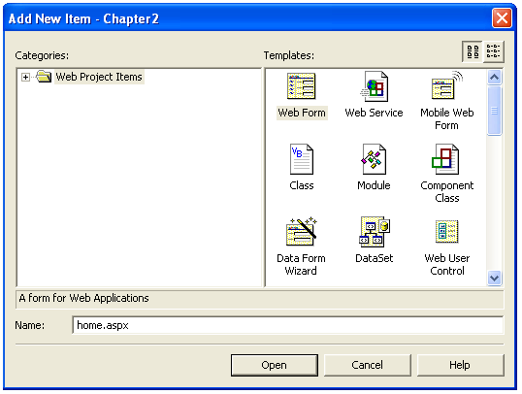
The Solution Explorer Window (continued)

Slide 13
The Toolbox
Commonly used controls
Organizes as tabs
  HTML tab – HTML controls
  Web Forms tab – ASP.NET Server controls
Can be hidden and can slide out like the other windows

Slide 14
Properties Window
Set the properties for objects, controls, and classes
Can set properties at design time or in the program code behind the page

Slide 15
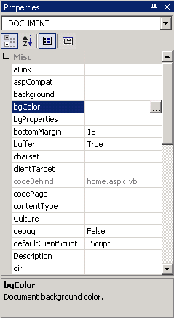
Properties Window (continued)

Slide 16
HTML Controls
HTML is a markup language
<hr noshade>
HTML standards set by World Wide Web Consortium (W3C)
XHTML is current version (XML compliant)
  Requires beginning and closing tags
  If no closing tag, use < tag name />
<hr noshade=“noshade” />

Slide 17
HTML Controls (continued)
HTML Designer
  Design view – a graphical user interface
  HTML view – HTML code editor
MS_POSITIONING property of BODY tag
  GridLayout – absolute position objects on the page
  FlowLayout – position elements in top-down format
The targetSchema property – browser version
IntelliSense – tries to predict what you will type

Slide 18
Creating an HTML Page
Create the feedback.htm page (PP. 53-57)
  Add the new page
  Set the page properties
  Insert an image
  Insert tags in code view, in Design view
  Modify the position of elements
  Insert tags in Design view using the Toolbox
Save and build the solution

Slide 19
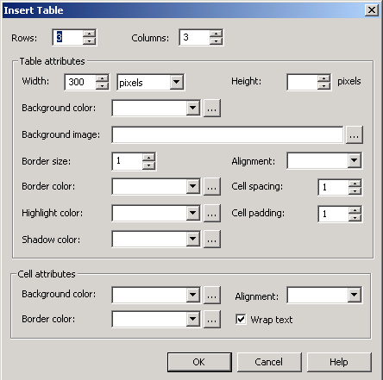
Creating an HTML Page (Figure 2-6)

Slide 20
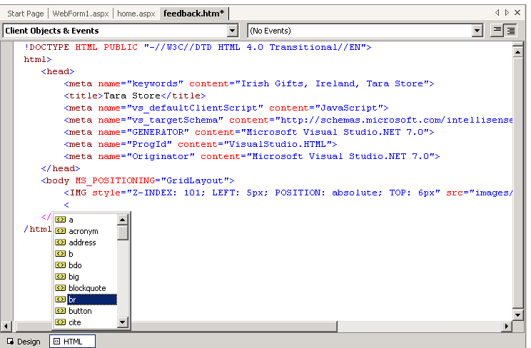
IntelliSense

Slide 21
Previewing Your HTML Page
Preview the page in the external and internal browser
  From the browser within Visual Studio .NET
    Right-click the web page, then click View in Browser.
  From Internet Explorer
    Enter http://localhost/Chapter2/feedback.htm

Slide 22
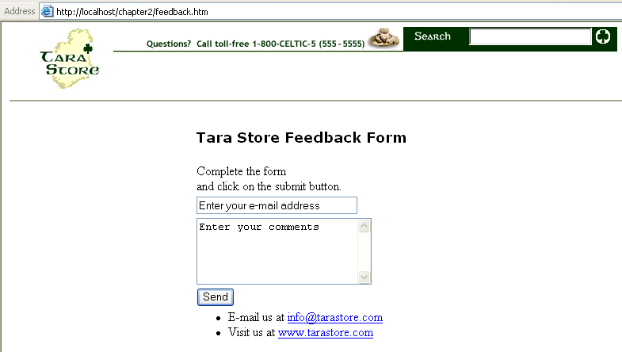
Previewing Your HTML Page (continued)

Slide 23
User Controls
Separate content and programming code that can be reused
Easier to maintain
Examples:
  heading, footers, menus
  lists of records returned from a database
  commonly used forms
The User Control
  compiled file ends in .ascx
  first line identifies the file using the keyword Control
  cannot have <html><head><body><form> tags

Slide 24
User Controls (continued)
Create the control (Ch2_Months.ascx)
      <%@ Control %>
      <select id=months>
      <option>January</option>
      <option>February</option>
      <option>March</option>
      <option>April</option>
      <option>May</option>
      <option>June</option>
      <option>July</option>
      <option>August</option>
      <option>September</option>
      <option>October</option>
      <option>November</option>
      <option>December</option>
      </select>

Slide 25
User Controls (continued)
Registered with the Web page with @Register directive
  TagPrefix is used to identify the User Control’s namespace
  TagName is the name of the control
  <TagPrefix:TagName id = "TagID" runat = "server"/>

Slide 26
User Controls (continued)
Register the control in the Web page
  <%@ Register TagPrefix="Months" TagName="ListMonths" src="Ch2_Months.ascx" %>
Insert the control anywhere in the page
  can reuse any user control many times
  must provide a unique ID
  <Months:ListMonths id = "ListMonths1"
  runat = "server"/>

Slide 27
Creating and Registering a User Control
Create and Register a User Control (PP. 60-62)
  Create header.ascx
  Insert an image
  Add code to display a message and the date
    date is an object
    format date with ToShortDateString
Modify the home.aspx page in HTML code view
  Register the User Control
  Insert the User Control
  Save, build, an preview the page

Slide 28
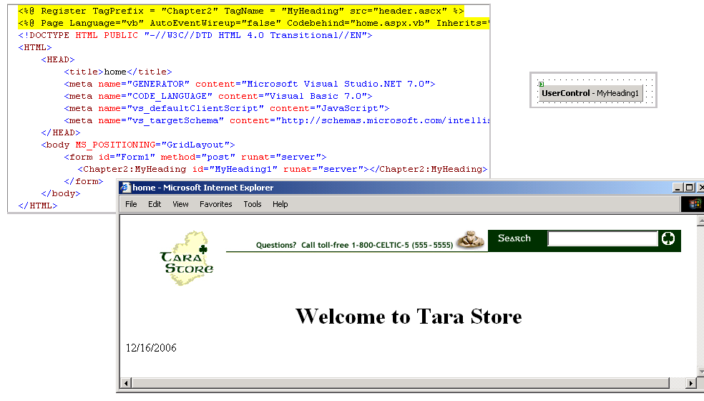
Creating and Registering a User Control (continued)

Slide 29
Creating Cascading Style Sheets
Store information on how to present the site
Separates content from presentation
W3C sets standards for CSS
Style Builder is graphical user interface to CSS

Slide 30
CSS Overview
A style rule is the information that is applied to a single HTML tag, or a group of tags
Name and value of the style is stored
Syntax for the rules vary
  Inline rules apply to a single tag
  Embedded rules apply to all elements within a single Web page
  External rules apply to all elements within multiple Web pages

Slide 31
Inline Style Sheets
Placed inside the tag
  Use the keyword style
  Separate name and value pair with semicolon
  <tagname
  style= "property1:value1;property2:value2">
  Content goes here
  </tagname>
  <H1 style= "color:green;">
  Welcome to Tara Store!</H1>

Slide 32
Embedded Style Sheets
Placed in the heading section
  Use the <style></style> tags
  Separate name and value with =
  Separate pairs with ;
    <HTML><HEAD><TITLE>Sample Embedded Style Sheet</TITLE>
    <STYLE>
    H1{
    color=green;
    font-size=12;
    }
    </STYLE>
    </HEAD>
    <BODY>
    <H1>Welcome to Tara Store!</H1>
    </BODY></HTML>

Slide 33
External Style Sheets
<LINK> tag attaches the style sheet to the page
  REL property – indicates that the linked document contains a style sheet
  TYPE property – means the linked file is a text/css MIME type
  No need for <style> tag, same format as embedded
  HREF – the location of the file (relative or absolute URL)
  Placed in the heading section
  <Link rel=stylesheet type="text/css" href="URL ">

Slide 34
Comments Within Cascading Style Sheets
/* */ can be used to comment embedded or external style sheets
    /* Styles.CSS
    Created By: Katie Kalata
    Date Created: 9/5/2005
    This style sheet is used to format the main menu
    */
    /* Corporate logo */
    H1 {color:green}
    /* Red heading */
    H2 {color:red}
    /* Blue heading */
    H3 {color:blue}

Slide 35
Cascading Style Sheet Rules
Cascading style sheets can contain conflicting styles rules.
This rule puts the “cascading” in cascading style sheets, in general:
  Inline takes precedence over Embedded
  Embedded takes precedence over External

Slide 36
Classes
Class can be used to format a group of different tags or a subgroup of a specific tag
Prefix the name of the class with a period
    <HTML><HEAD><TITLE>Sample Embedded Style Sheet</TITLE>
    <STYLE>
    H1 {color:green}
    .SelCat {color:red}
    .BlueHead {color:blue}
    </STYLE>
    </HEAD>

Slide 37
Classes (continued)
Apply the class with the keyword class
    <BODY>
    <h1>Welcome to Tara Store!</h1>
    <h2 class="BlueHead">Product Listing:</h2>
      <ul>
        <li>Gifts</li>
        <li class="SelCat">Jewelry</li>
        <li>China & Crystal</li>
        <li>Food</li>
        <li>Clothing</li>
        <li>Books, Music, & Videos</li>
      </ul>

Slide 38
Classes (continued)
Both headings would appear in blue
    <h3 class="BlueHead">About Tara Store</h3>
      <ul>
        <li>What’s New</li>
        <li>Current Sales</li>
        <li>Location</li>
        <li>Contact Us</li>
        <li>Members Only</li>
      </ul>
    </BODY></HTML>

Slide 39
CSS Editor
CSS editor called the Style Builder
includes the IntelliSense feature
Color Picker
  Web Colors tab - 216 colors supported by the majority of computers and browsers
  Named Colors tab - the 16 Windows colors and the 122 other named colors
  System Colors tab - select a color that matches the colors used to create system graphical user interfaces such as windows, menus, scrollbars, and buttons
  Custom Color tab - three slider controls to select the red, green, and blue (RGB) values

Slide 40
Creating a Cascading Style Sheet
Modify the styles.css sheet (PP. 68-73)
  Modify the style properties and values
  Edit the style sheet manually, use IntelliSense and use the Style Builder
  Add style rules
  Save the file
  Link the file to the feedback.htm page
  Preview the page in the browser

Slide 41
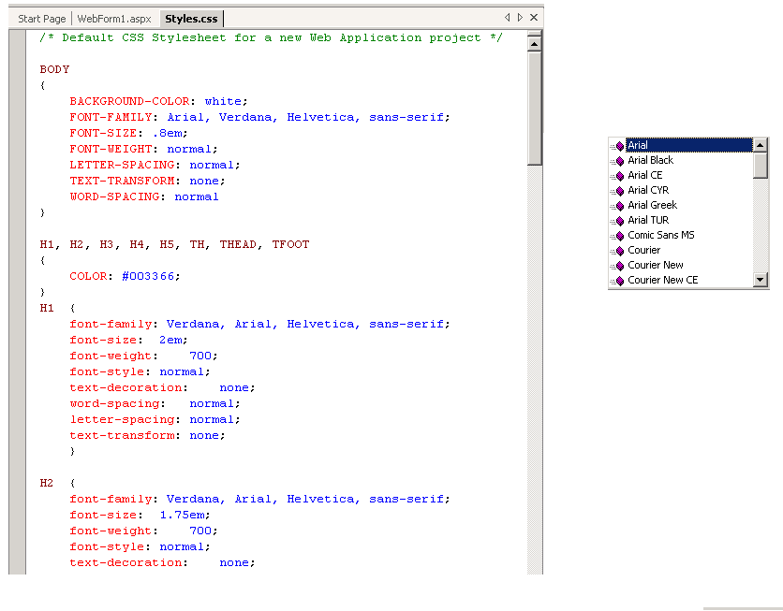
Creating a Cascading Style Sheet (continued)

Slide 42
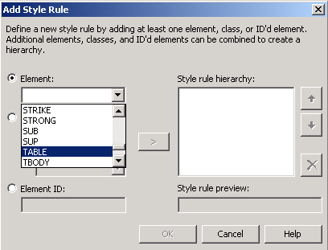
Creating a Cascading Style Sheet (continued)

Slide 43
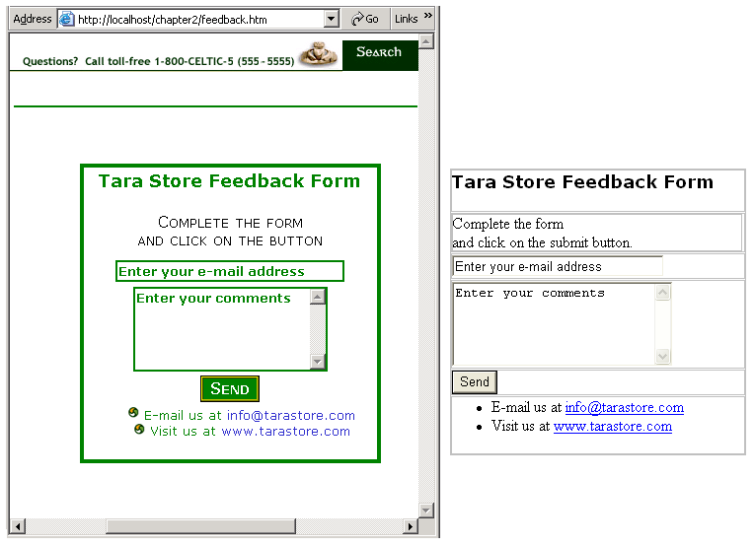
Creating a Cascading Style Sheet (continued)

Slide 44
Customizing the Toolbox
Customize the Toolbox (P.74)
  Create a new tab
  Add a markup code fragment to tab and rename the control
Toolbox – add additional tabs to organize controls
Clipboard Ring - stores the list of items copied to the Clipboard
Clipboard – area in memory that Windows uses to copy information

Slide 45
Summary
Visual Studio .NET IDE layout can be customized
Solution Explorer manages files and folders in one location
Properties window sets properties for objects
Toolbox organizes commonly used controls and can be customized

Slide 46
Summary (continued)
HTML editor is used to create HTML pages in Design View or Code View
User Controls – Contain controls and programming code; must be registered in the ASP.NET page before they are used
Inline style sheets apply style rules to a single tag; embedded to a Web page; external to more than one page

